Slide 1


Semicolons 2025
Persistent’s Annual Global Hackathon
Data Dynamite

Slide 2
1) Predict food requirements for next day and reduce food wastage 2) Smart Food Demand Prediction 3) DATA DYNAMITE
Customer/ Market Need
“Customers need an accurate demand forecasting system to optimize food preparation, reduce wastage, cut costs, and improve efficiency by adapting to changing footfall, holidays, and operational trends.”
Our Solution ( Approach - AI)
“We use AI-driven predictive modeling to forecast food consumption and wastage per facility based on historical data, ensuring accurate demand estimation, reducing waste, and optimizing resource allocation with heatmap visualizations.”
Key Features
Dashboard Interactive UI with real-time food demand insights and trends | Data Analyzer Logs, processes, and visualizes historical data for better predictions.
Reports & Insights Generates detailed reports on demand trends, wastage reduction, and efficiency. | Prediction Engine Uses linear regression to forecast food requirements and minimize wastage.
Benefits to Customers
“Customers benefit from accurate forecasting, reduced food wastage, cost optimization, improved efficiency, with driven insights enabling smarter planning and minimizing expenses.”
Differentiators
“Our solution offers AI-driven demand forecasting, real-time insights, seamless FastAPI-React integration, adaptive predictions for holidays and footfall, and an intuitive, interactive dashboard for smarter decision-making.”
Buyer / User Persona
Target audience's characteristics, needs, behaviors, and preferences
Impactful Metrics
> 40% Enhanced customer satisfaction (by survey) | < 40% Reduction in downtime. | < 30% Reduction in Maintenance Cost
Notes:
The NABC (Need, Approach, Benefit, and Competition) framework, developed by Stanford Research Institute (SRI), is a structured way to analyze and present solutions to customer problems effectively. Here’s how you can apply it to a customer problem and use it in a pitch. 1. Need (Customer Problem Statement) • Clearly define the customer’s core problem or unmet need. • Quantify the impact (e.g., lost revenue, inefficiencies, risks). • Example (Telecom Industry): “Telecom companies struggle with network downtime and inefficient fault detection, leading to revenue losses and poor customer experience. Traditional monitoring systems are slow and reactive, causing delays in issue resolution.” 2. Approach (Your Solution) • Explain how your solution works. • Highlight any unique technology, processes, or methodologies. • Example: “Our AI-powered predictive maintenance platform analyzes network performance in real time, detecting anomalies before failures occur. Using machine learning models trained on historical data, we provide proactive alerts and automated issue resolution.” 3. Benefits (Value Proposition) • Describe the tangible benefits for the customer. • Use measurable outcomes like cost savings, efficiency gains, or revenue growth. • Example: “By deploying our solution, telecom providers can reduce downtime by 40%, lower maintenance costs by 30%, and enhance customer satisfaction by ensuring a seamless network experience.” 4. Competition (Market Differentiation) • Identify competitors and alternatives. • Highlight what makes your solution better (e.g., speed, accuracy, ease of use, pricing). • Example: “Unlike traditional rule-based monitoring systems, our AI solution learns and adapts over time, offering predictive insights rather than reactive responses. Compared to competitors, our platform integrates seamlessly with existing infrastructure and provides deeper analytics.” Pitch Structure Using NABC 1. Introduction (Hook the audience with the Need) • “Did you know that telecom operators lose millions annually due to unexpected network failures?” 2. Explain the Approach • “Our AI-driven platform predicts failures before they happen, ensuring proactive maintenance.” 3. Showcase the Benefits • “This reduces downtime by 40%, enhances customer satisfaction, and cuts operational costs.” 4. Highlight Differentiation • “Unlike traditional methods, our solution adapts in real time, providing a smarter, automated approach to network management.

Slide 3
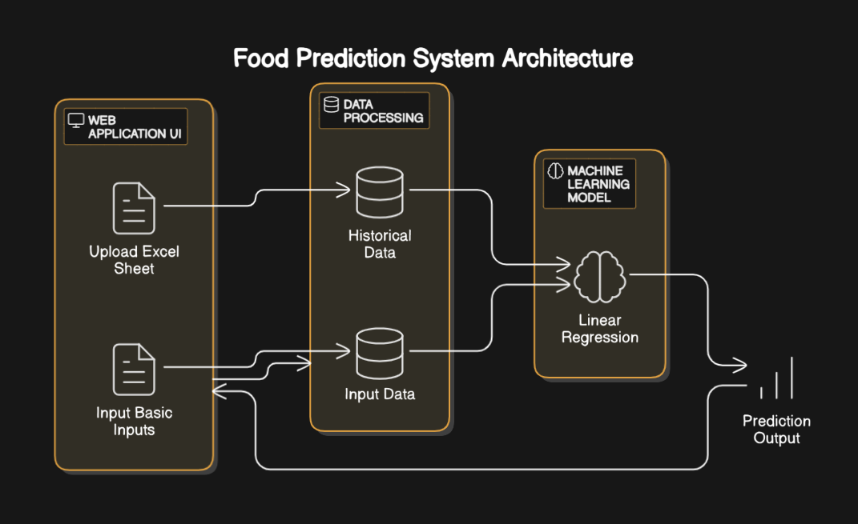
Architecture Diagram

Slide 4
Why Linear Regression
Linear Regression
K means Cluster
Decision Tree Regression
Supervised (predicts numeric values)
Provides continuous numerical output
Less prone to overfitting, generalizes well.
Shows clear relationships between variables
Fast and scalable
Works best with linear relationships
Best for forecasting numeric values (e.g., food demand)
Unsupervised (groups similar dat
Clusters data but doesn’t predict values
No risk of overfitting, but results depend on K
Difficult to explain why data is grouped
Computationally expensive for large datasets
Does not explicitly model relationships
Best for grouping similar data but not forecasting
Supervised (predicts numeric values)
Creates stepwise, segmented predictions
High risk of overfitting, needs pruning
Harder to interpret due to tree splits
Slower, especially with deep trees
Handles non-linear relationships better
Works well for categorical and structured decisions

Slide 5
Approach:
FastAPI Framework: Utilized FastAPI to build an API for uploading Excel files, training a linear regression model, and making predictions.
Data Preprocessing: Removed holidays and Sundays, converted categorical variables to numerical form, and ensured all columns were numeric where needed.
Model Training: Used a Linear Regression model trained on key features like footfall, lunch/snacks orders, and differences to predict actual consumption and wastage.
Training & Prediction Pipeline: Implemented endpoints for uploading an Excel sheet, training the model, and making predictions both from files and manual inputs.
Heatmap Visualization: Generated heatmaps using Matplotlib & Seaborn to visualize predicted consumption and wastage across different facilities.
Facility-Based Predictions: Allowed grouping of results by facility to analyze consumption and wastage patterns at a more granular level.

Slide 6
Challenges faced
Poor Data Quality
Inconsistent column names across sheets.
Missing and incomplete data in key fields (footfall, lunch/snacks ordered).
Remarks on Holidays
Holidays were not always explicitly mentioned.
Data Formatting Issues
Numeric fields stored as text.
Inconsistent date formats causing parsing issues.
Anomalies
Extreme variations in footfall and consumption.
Wrong inputs in columns
Feature Selection
Categorical variables like "day" and "facility" required encoding.

Slide 7
Future Scope
Enhanced Model Accuracy
Explore advanced ML models like Random Forest, XGBoost, or Neural Networks.
Incorporate time-series forecasting for better trend analysis.
Automated Data Cleaning & Preprocessing
Implement AI-driven data validation to handle missing values and outliers.
Develop a data pipeline for real-time ingestion and transformation.
Integration with IoT & Real-Time Data
Utilize IoT sensors to track real-time footfall and food wastage.
Implement API integration with cafeteria ordering systems.
AI-Driven Decision Making
Implement dynamic pricing strategies based on demand patterns.
Develop a smart recommendation system for optimal food ordering.

Slide 8

Thank you!

